Slide 1
CSCI-6660-02 Introduction to Artificial Intelligence Training a Mario Agent with Reinforcement Learning
Instructor: Shivanjali khare
PROJECT TEAM MEMBERS
1. Meghana Vasamsetty
2. Pavani Karnati

Slide 2
Introduction
Training a Reinforcement agent – Mario agent to learn how to play a mario game by itself using Double deep Q-Networks.
Using OpenAI Gym environment for Super mario Bros to train an agent using the nes-py emulator.
Returns the Mean reward value , Mean loss value and Mean Q value for the set of episodes.
Resulting in a simulation of training a Mario Agent.

Slide 3
Understanding Reinforcement Learning
Reinforcement learning is a branch of machine learning focused on training agents to learn from interaction with an environment.
The agent perceives the environment, takes actions, and learns from the rewards or penalties received.
For instance, in the game Pacman, the player (agent) takes actions based on rewards obtained from the game environment.

Slide 4
Keywords
Reinforcement learning involves the following key concepts:
Environment: The world the agent interacts with and learns from.
Action(a): How the agent responds to the environment. The set of possible actions is the action-space.
State(s): The current situation of the environment. The set of possible states is the state-space.
Reward(r): Feedback from the environment to the agent, driving learning and behavior.
Optimal Action-Value Function (Q∗): Estimates the expected return for taking an action in a state.

Slide 5
Tools and Packages
Setup Mario Environment:
Executed on: Anaconda-Jupyter Lab
Framework: Gym -Toolkit used for developing and comparing RL algorithm, It supports teaching agents from walking , playing games etc.
Environment: gym-super-mario-bros==7.3.0
Platform:Pytorch
Actions: (joypad space): from nes-py is an NES emulator and OpenAI Gym interface used to build a virtual joypad to play mario game
Wrappers :To preprocess environment data before sending it to the agent

Slide 6
The Mario Agent
Our agent, represented by the Mario class, will:
Act based on the optimal action policy given the current state.
Maintain an experience log of (state, action, reward, next state) for learning.
Learn and update its action policy over time.
Choose optimal actions during exploitation and random actions during exploration.

Slide 7
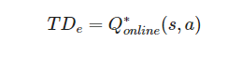
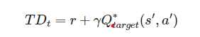
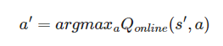
Training Model
Mario uses DDQN algorithm (Deep Reinforcement Learning with Double Q-learning) - uses two convoluted networks that independently approximate the optimal action-value function
Predicted Optimal Q* for each state
The aggregation of current rewards and estimated Q* is given by

Slide 8
Implement and compare model-free RL Algorithm
Policy gradient methods in reinforcement learning optimize parameterized policies to maximize the expected return through gradient descent.
These methods focus on stochastic policies represented by parameters.
The goal is to derive the analytical gradient of policy performance, typically in the form of an expected value, and then estimate this value using sample data from agent-environment interactions.
This process enables the numerical computation of the policy gradient, facilitating policy updates for improved performance.

Slide 9
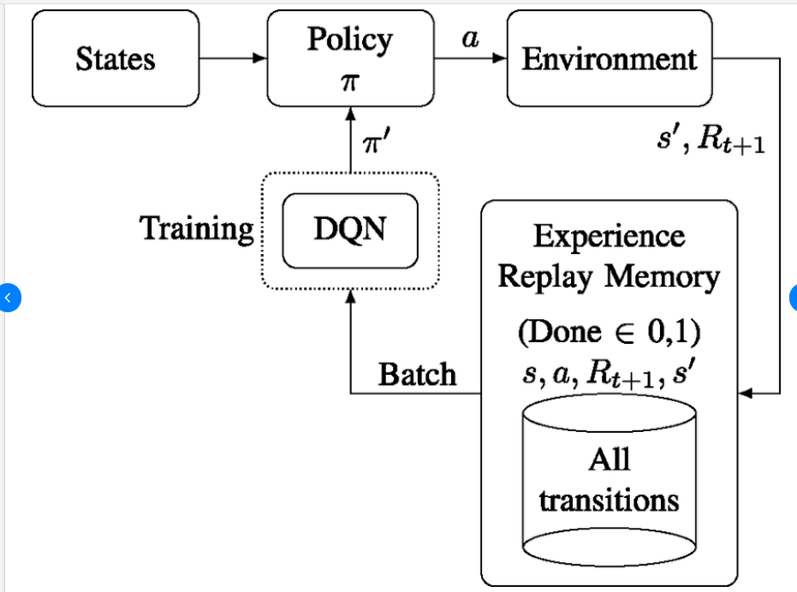
Training Model

Slide 10
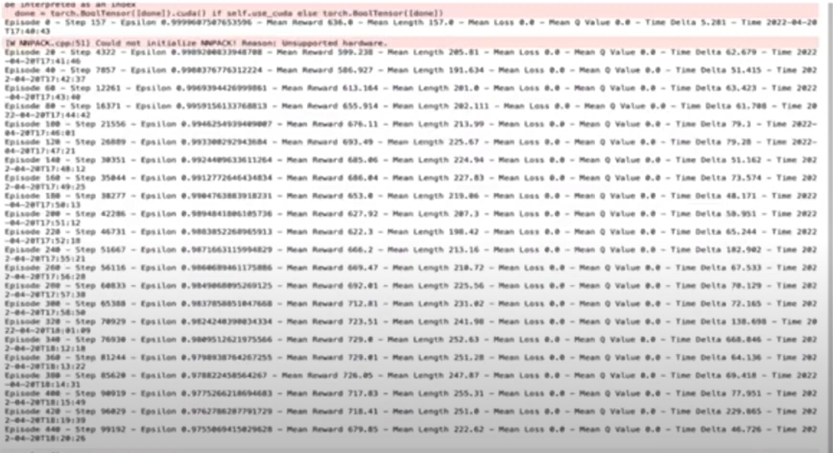
output

Slide 11
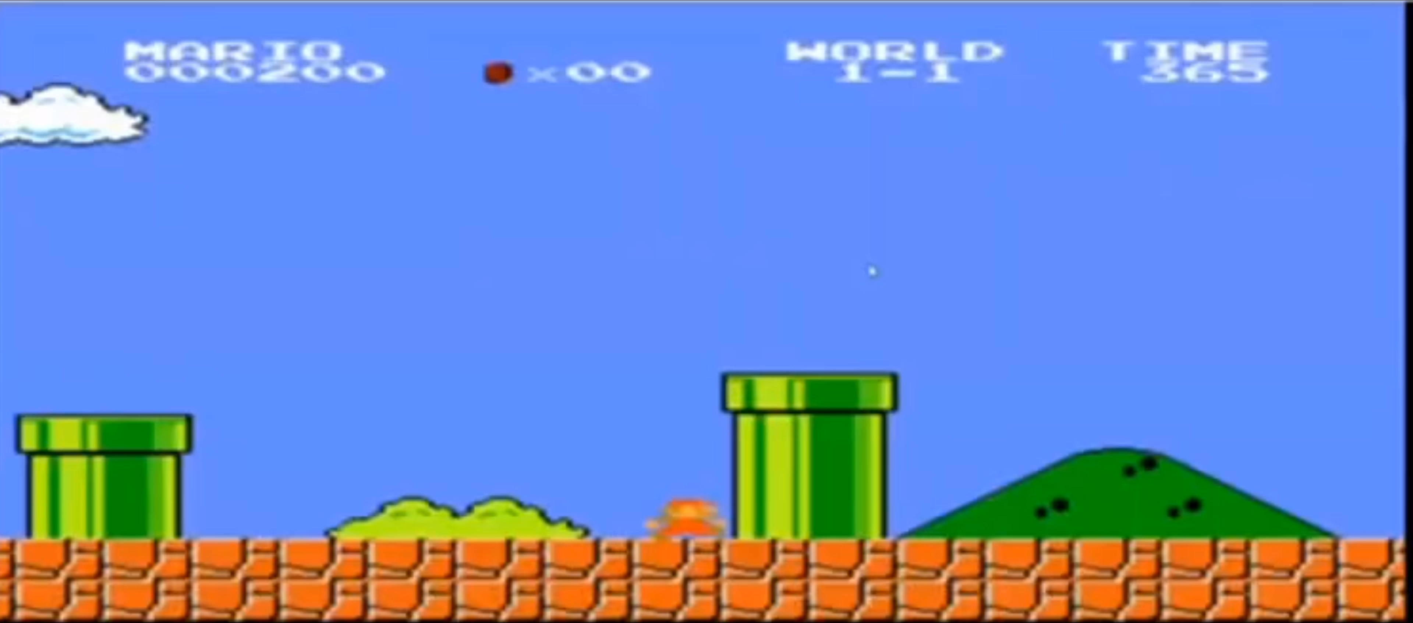
Output video

Slide 12
Inference
We've demonstrated the practical implementation of reinforcement learning techniques to construct learning models within specific environments and train agents using them.
Reinforcement learning finds applications in various domains such as:
Self-driving cars: RL algorithms train agents to navigate real-world environments safely.
Industrial automation: Agents learn to optimize processes and reduce costs in manufacturing.
Trading and finance: RL models predict market trends and optimize trading strategies.
Natural Language Processing (NLP): RL algorithms improve conversational agents and language understanding systems.

Slide 13
References
Mnih, Volodymyr, et al. "Human-level control through deep reinforcement learning." Nature 518.7540 (2015): 529-533.
Silver, David, et al. "Mastering the game of Go with deep neural networks and tree search." Nature 529.7587 (2016): 484-489.
Sutton, Richard S., and Andrew G. Barto. Reinforcement learning: An introduction. MIT press, 2018.
Hessel, Matteo, et al. "Rainbow: Combining improvements in deep reinforcement learning." Proceedings of the AAAI Conference on Artificial Intelligence. Vol. 32. No. 1. 2018.
Kober, Jens, J. Andrew Bagnell, and Jan Peters. "Reinforcement learning in robotics: A survey." The International Journal of Robotics Research 32.11 (2013): 1238-1274.

Slide 14
THANK YOU!

